Slide 1



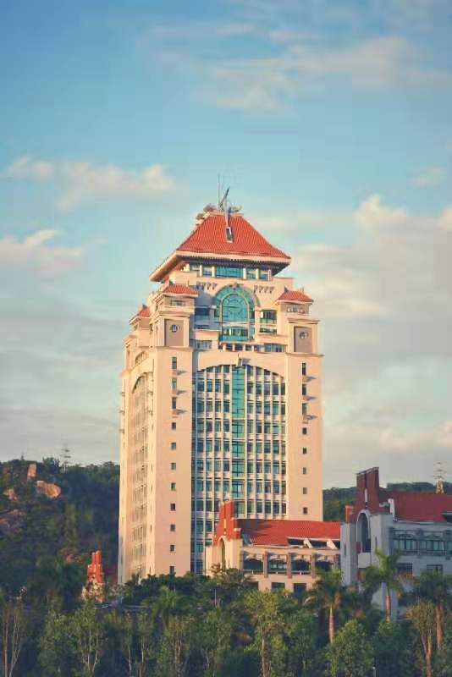

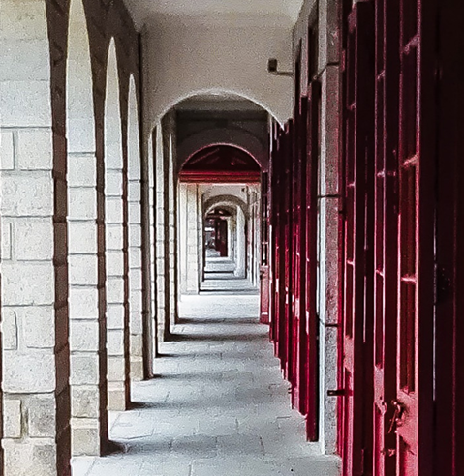
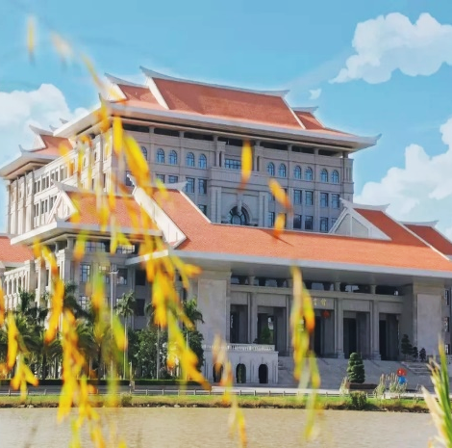

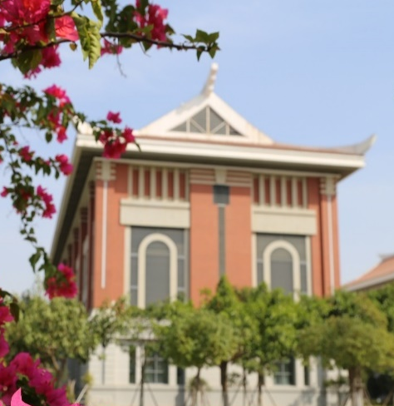

Who‘s who？
Contemporary Br. Oral Presentation
Xu Huang at XMU

Slide 2


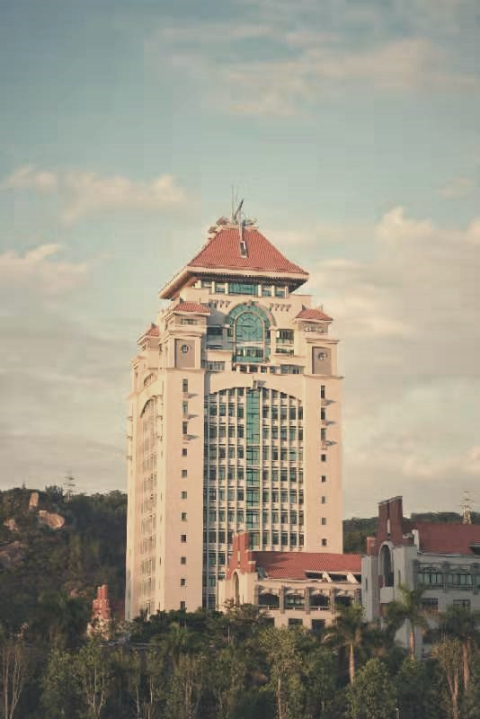


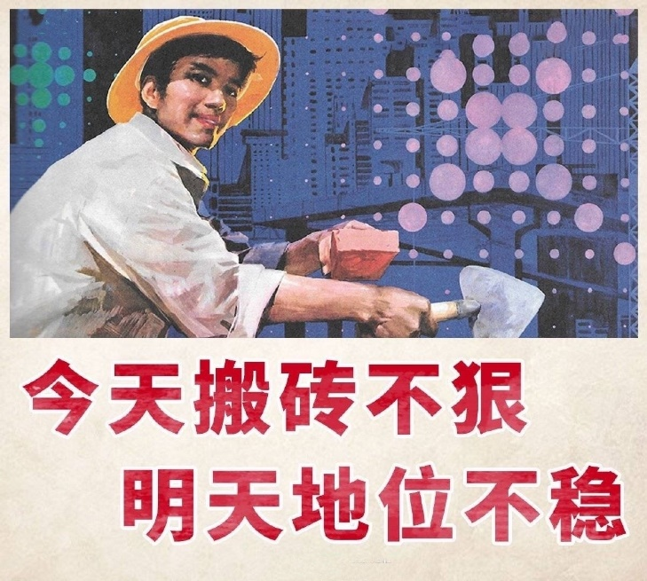

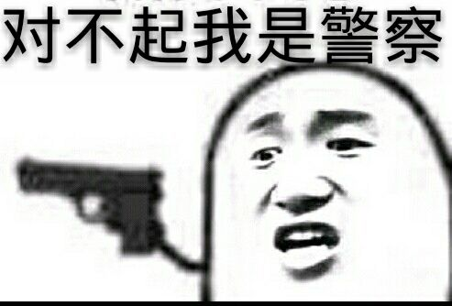




police
workmen

Slide 3




deception骗局，戏弄
hoax

Slide 4



1
a mature mind
2
take care of others

Slide 5
Thanks
Contemporary Br. Oral Presentation
Xu Huang at XMU

